Slide 1
Linear Classification using Perceptron Algorithm
Presentation by : Nipun Sharma

Slide 2
Perceptron Algorithm in Simplistic Terms
An algorithm for decision making in Binary Terms.
Decision / Output of the Perceptron Algorithm is either 1 or 0. (So it will classify data points/objects in two distinct categories)
Perceptron Algorithm decides a threshold based on which it will classify data points/ objects.
if calculated value of Perceptron Algorithm z(x) > Threshold = 1
Perceptron Algorithm z(x) < Threshold = 0

Slide 3
General Formula for Perceptron Algorithm
Perceptron Algorithm is an old Machine Learning Algorithm (from early 60s)
For a data set with n features specified by x₁, x₂, x₃,......., x_{n}
For simplicity if the threshold is taken as 0 it assigns
Output
z = 1 if w₁x₁ + w₂x₂ + w₃x₃ + ............ w_{n}x_{n} >0
z = 0 if w₁x₁ + w₂x₂ + w₃x₃ + ............ w_{n}x_{n} <0
A non-zero threshold can also be simulated by keeping a bias in the beginning.

Slide 4
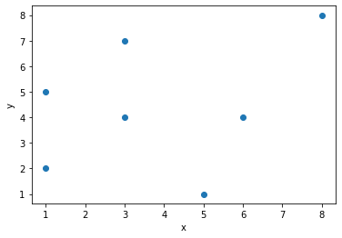
R2 SPACE
R2 space is a 2-dimensional space with each point having own value of x,y if the two axes are named as x and y.

Slide 5
Perceptron Algorithm for R2 space
R2 space is a 2-dimensional space with x-y coordinates. Each point in this x-y 2-dimensional plane is characterised by its x and y value on the axes.
In R2 space the perceptron algorithm takes up even simpler format as there are only two input variables associated with each data point.
The output of the ML system of R2 space working on perceptron algorithm would be
z = w_{x} * x_{i} + w_{y} * y_{i}
where
w_{x} is weight of x
w_{y} is weight of y

Slide 6
Linear R2 Classification
Z is calculated for each data point and each data point is classified by the following criteria.
If z >0 data point is assigned classifier 1
If z< 0 data point is assigned classifier 0

Slide 7
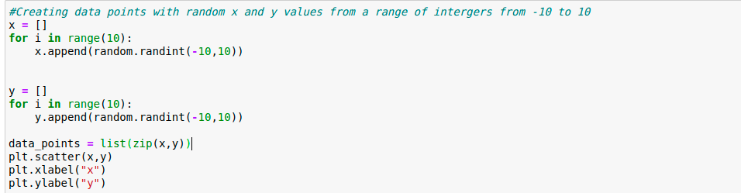
Python implementation of Perceptron Algorithm on R2 space
Implementation in Jupyter Notebook

Slide 8
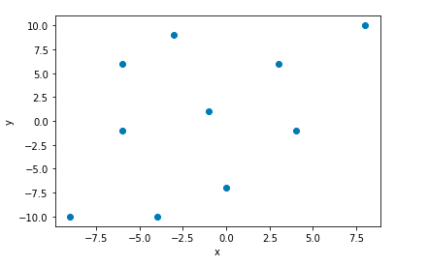
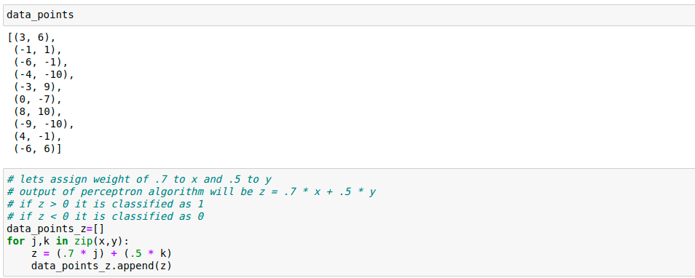

Slide 9
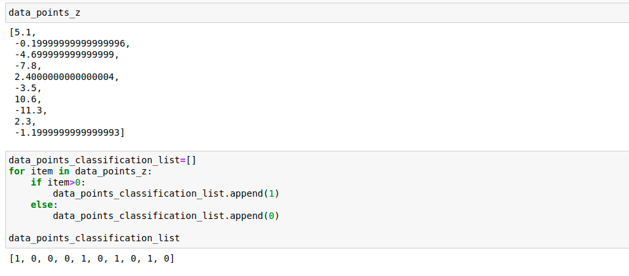

Slide 10
Live Dynamic Perceptron Algorithm linear classification on Jupyter Notebook

Slide 11
Thanks

